Slide 1
Mood lamp
Laurie Fitzek

Slide 2
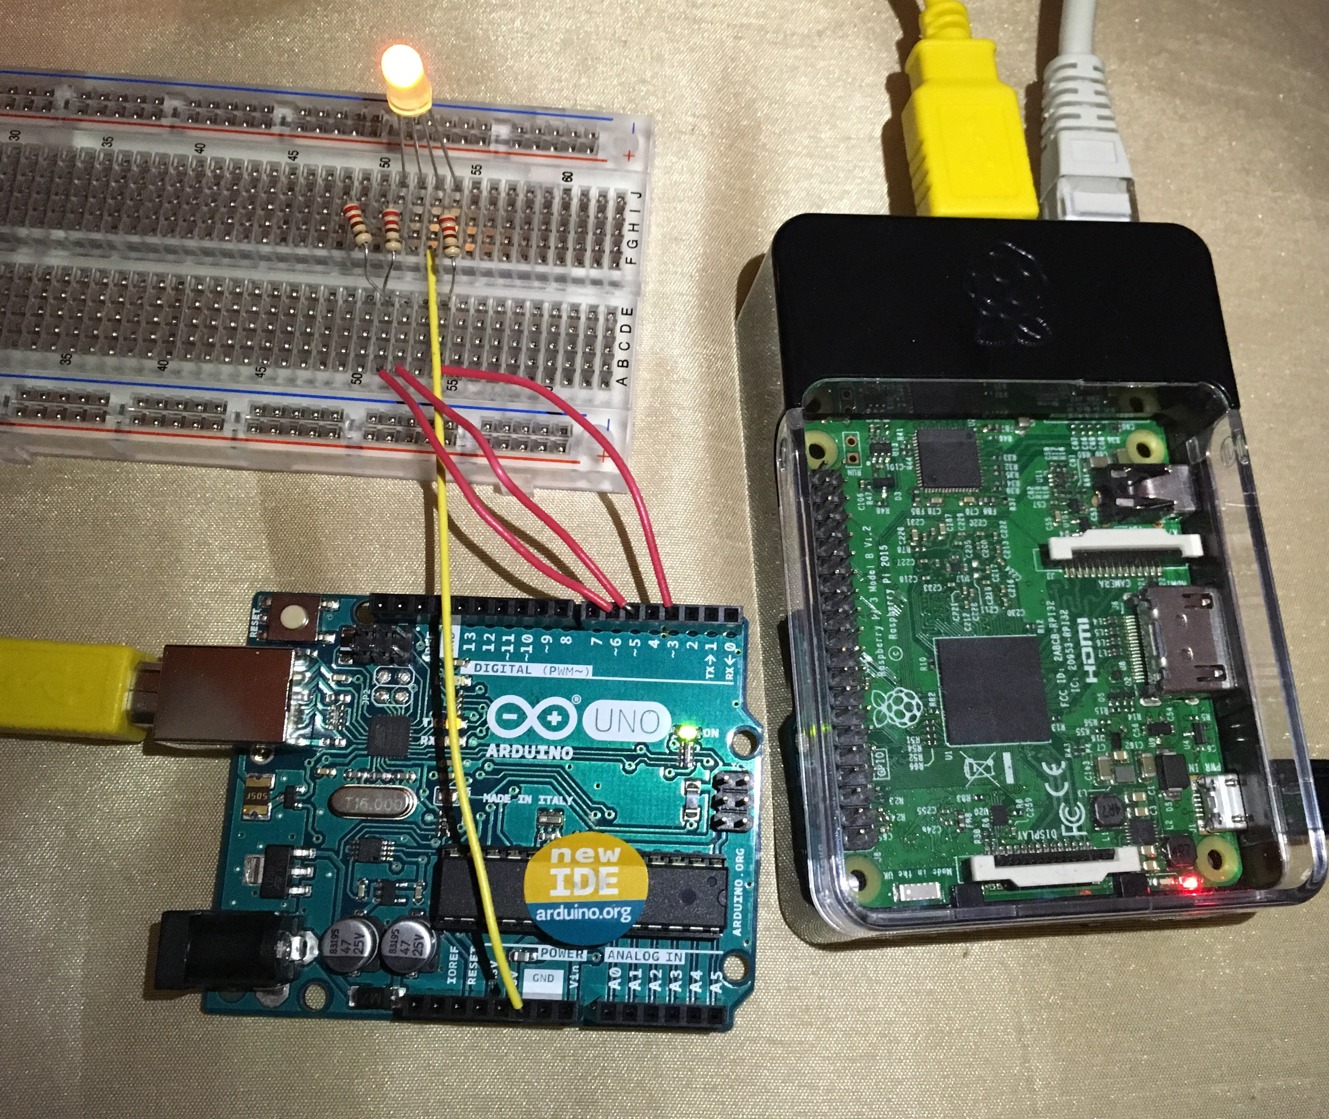
Project overview
To have a functioning mood lamp controlled by an app and/or sensitivity to light, sound and temperature.
Why?
It sounded good.

Slide 3
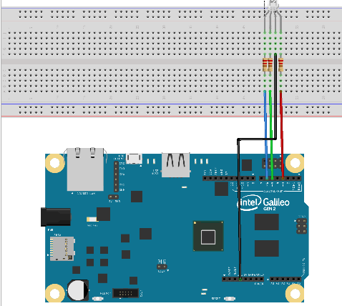
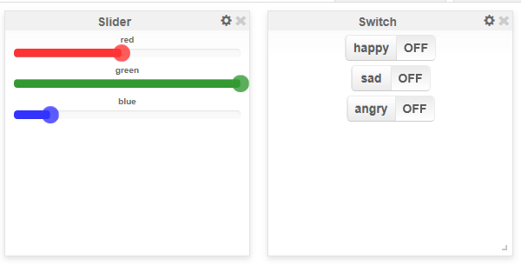
Project design
RGB Led Light Circuit

Slide 4
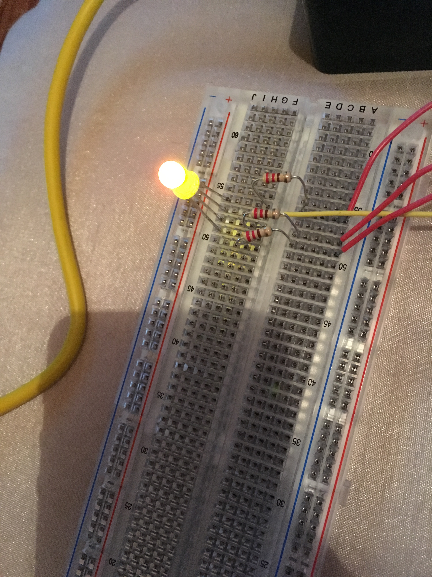
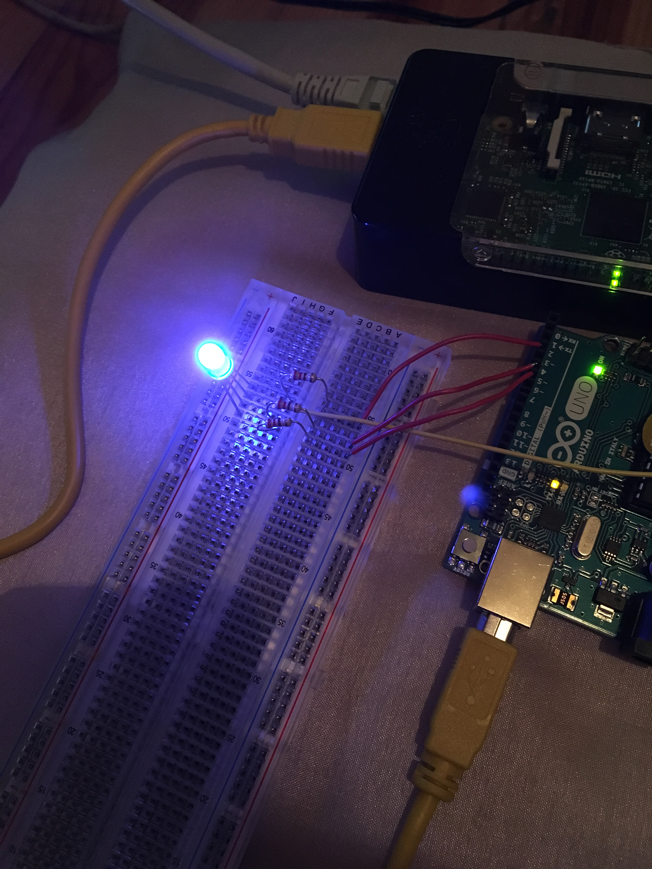
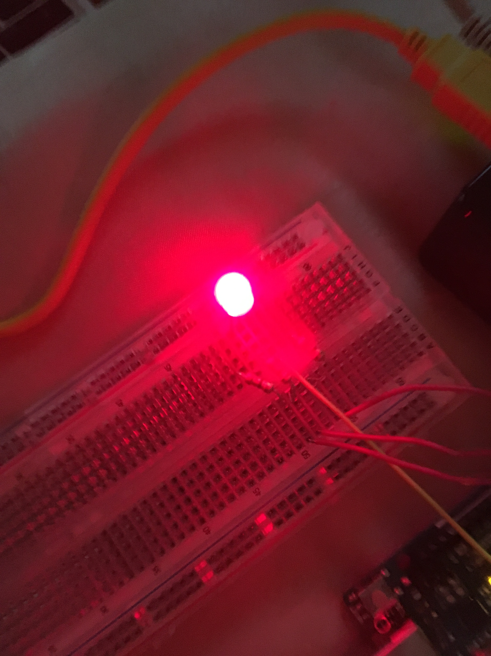
PROJECT Design
Happy
Sad
Angry
Yellow Light
Blue Light
Red Light

Slide 5



Project design
Technology & Skills
Raspberry Pi connected to Wyliodrin
Using Streams
Arduino connected to Raspberry Pi
Programming

Slide 6
Progress so far
Wyliodrin ->
Buttons for moods
01
QR Scanner -> Controlled on phone
02

